Slide 1
The Technology Value Stream
Caitlynne Johnson

Slide 2
Technology Value Stream
The technology value stream is defined as “the process required to convert a business hypothesis into a technology-enabled service that delivers value to the customer.”
The input to the process is the formulation of a business objective, concept, idea, or hypothesis.
It is important to not only deliver fast flow, but make sure that deployments can also be performed without causing chaos and disruptions like service outages, service impairments, or security or compliance failures.

Slide 3
Lead Time
Lead time is one of two measures commonly used to measure performance in value streams.
It is defined as “the amount of time that passes from the start of a process until its conclusion.”
Reducing lead time can streamline operations and improve productivity as well as increase output and revenue.
Long lead times can negatively affect sales and manufacturing processes.

Slide 4
Importance of a Short Lead Time
Having a shorter lead time may lead to:
Happier customers.
Less obsolescence.
Less labor costs.
More orders.
More efficient capital deployment.

Slide 5
Processing Time
It is defined as “the time a product actually is being worked on in design or production and the time an order actually is being processed.”
Processing time is a small fraction of production lead time.

Slide 6
Importance of Processing Time
The benefit of Processing Time allows a team or organization to:
Estimate overall process lead time.
Identify potential opportunities.
Process balance.

Slide 7
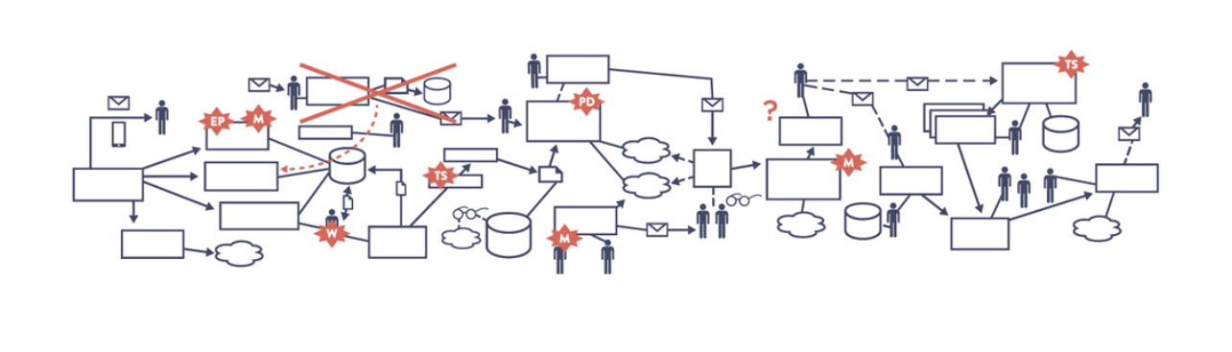
Deployment Lead Time
Many teams and organizations end up in situations where deployment lead times require months.
This is especially common with large, complex organizations that are working with tightly couple, monolithic systems that have scare integration test environments, long test and production lead times, high reliance on manual testing, and multiple required approval processes.
The value stream may look like this when such occurs:
Source: Damon Edwards, “DevOps Kaizen”, 2015

Slide 8
Deployment Lead Time Continued
When there are long deployment lead times, heroics are required at almost every stage of the value stream.
Lead times can range from days to months.

Slide 9
Deployment Lead Times of Minutes
In the DevOps ideal, developers receive fast, constant feedback on their work which enables them to quickly and independently implement, integrate, and validate their code so that it can be deployed to the production environment.
This enables developers to have a high degree of confidence that their changes will operate as designed in production and that any problems be quickly detected and corrected.
It is easily achieved if there is architecture that is modular, well encapsulated and loosely coupled so that small teams can work with high degrees of autonomy.
This means failures will be small and contained and won’t cause any global disruptions.

Slide 10
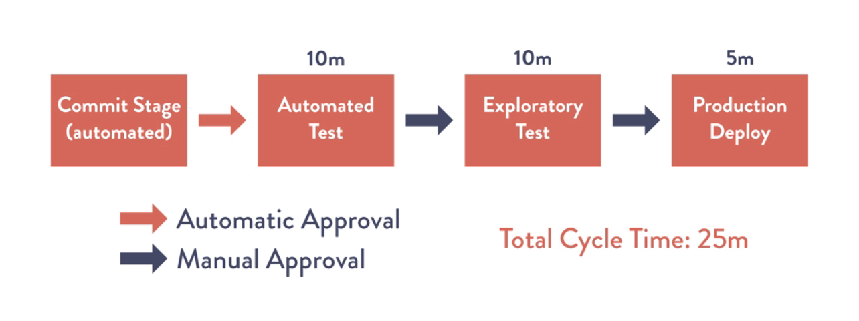
Deployment Lead Times of Minutes Continued

Slide 11
References
Kenton, W. (2023, May 11). Lead time: Definition, how it works, and example. Investopedia. https://www.investopedia.com/terms/l/leadtime.asp
Cycle time - how to calculate it. Lean Enterprise Institute. (2022, May 23). https://www.lean.org/lexicon-terms/cycle-time/#:~:text=Typically%2C%20processing%20time%20is%20a%20small%20fraction%20of,plant%20level%20this%20often%20is%20termed%20door-to-door%20time.
Feldman, K. (2019, October 15). Process time. isixsigma.com. https://www.isixsigma.com/dictionary/process-time/
Brown, N. (2021, May 24). Taking devsecops to the next level with value stream mapping. SEI Blog. https://insights.sei.cmu.edu/blog/taking-devsecops-to-the-next-level-with-value-stream-mapping/#:~:text=The%20technology%20value%20stream%20is%20%E2%80%9Cthe%20process%20required,development%2C%20quality%20assurance%2C%20IT%20operations%2C%20and%20information%20security.
DEVOPS Handbook: How to create world-class Agility Reliability, & security in. (2021). IT REVOLUTION PR.

